Slide 1

Employee Attrition Analysis
Presented by - Amey Phatak

Slide 2


Introduction:
Objective:
To analyze factors influencing employee attrition and provide actionable solutions.
Data Analyzed:
Job role, Business travel, Stock options, Salary hikes, Promotion history, Gender, Marital Status, Job Satisfaction and more.

Slide 3

Attrition by Job Role & Monthly Income
High Attrition in Three Roles:
70% of total attrition comes from three roles:
Laboratory Technician: 62 employees
Research Scientist: 47 employees
Sales Executive: 57 employees
2. Significant Workforce Impact:
These roles make up 59% of the total workforce.

Slide 4
2.Salary Disparity:
Employees in these roles have lower average salaries compared to higher-paying roles:
Laboratory Technician: 3237
Research Scientist: 3240
Sales Executive: 6924
Higher-paying roles include:
Manager: 17182
Research Director: 16034

Slide 5

Solution 1 :
Increase
Increase salaries for these roles to align with market standards.
Create
Create career growth opportunities to encourage employee development.
Offer
Offer performance bonuses to incentivize and retain talent.
Implement
Implement engagement programs to boost morale and improve retention.

Slide 6
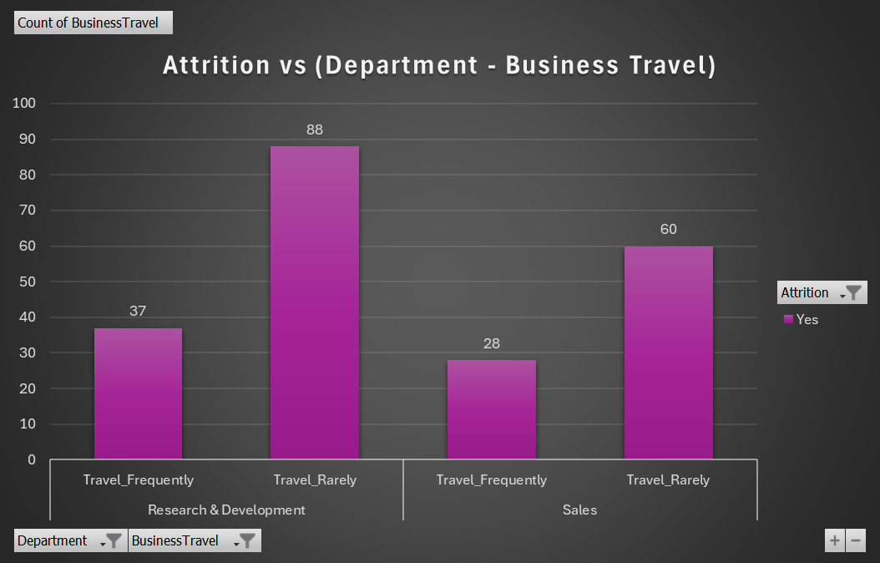
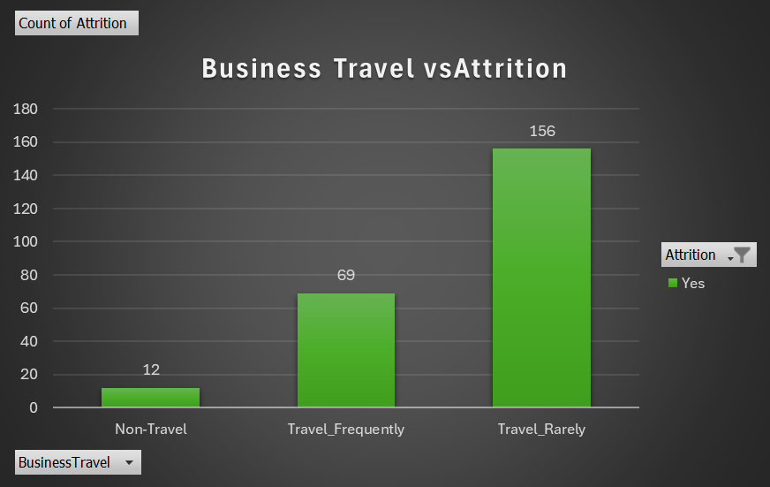
Attrition by Business Travel & Department
1. Higher Attrition in Traveling Employees:
66% of employees who travel rarely (156 employees) and 29% of employees who travel frequently (69 employees) have left the company.
Only 5% of non-traveling employees (12 employees) have left.
2.Departmental Impact:
Research & Development: 133 employees who left were from this department.
Sales: 92 employees who left were from this department.

Slide 7


Solution 5:
Revise Travel Policies:
Travel Incentives:
Work-Life Balance Programs:

Slide 8
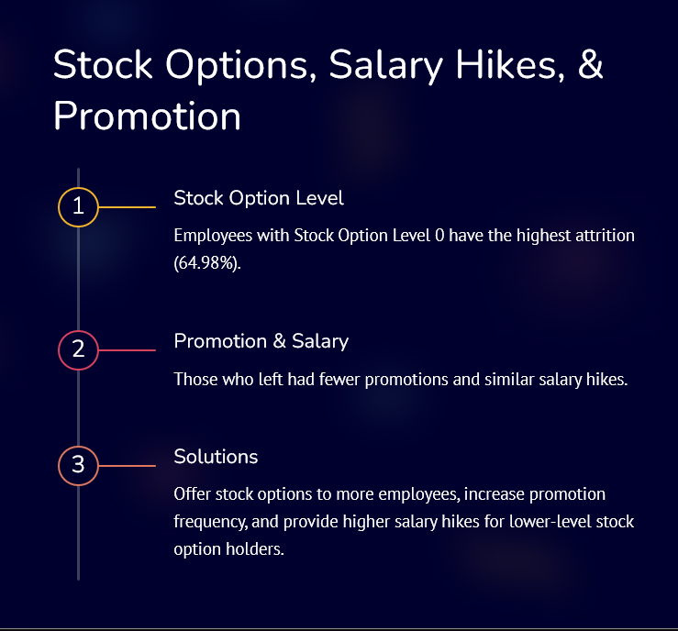
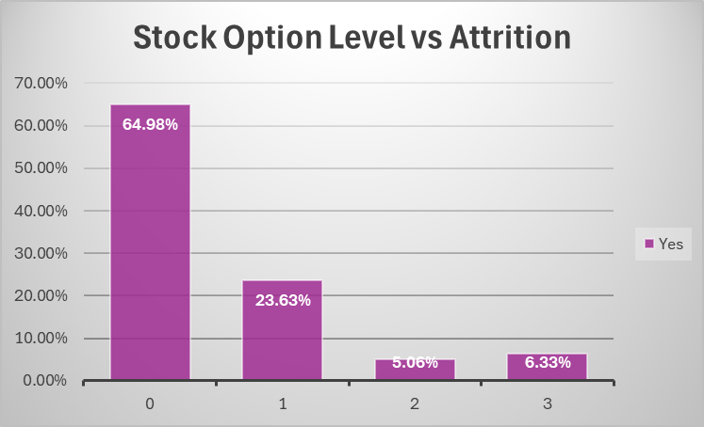
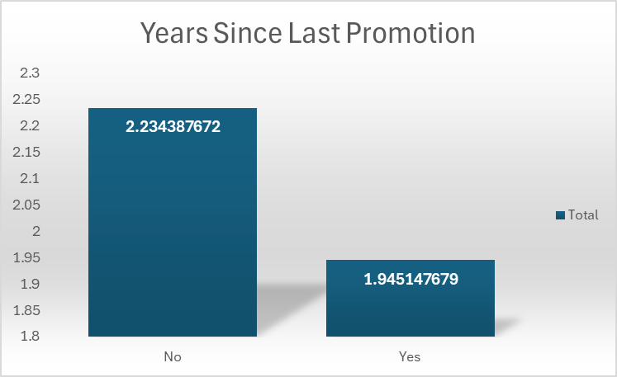

Slide 9
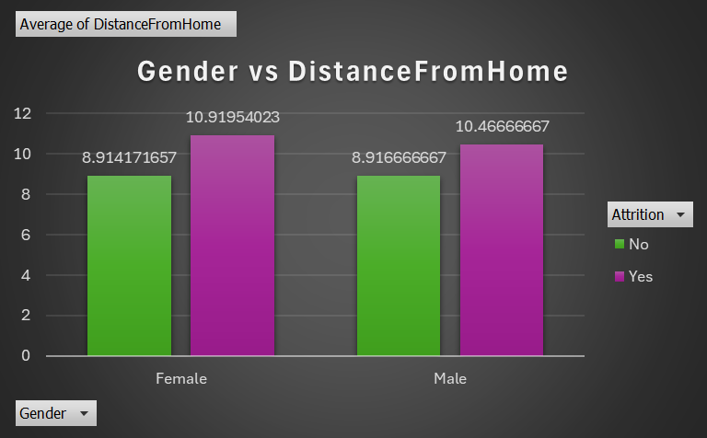
Attrition by Gender, Marital Status & Distance from Home
Gender Breakdown of Attrition:
63% of employees who left were male.
Marital Status:
51% of employees who left were single
Distance from Home:
Employees who left lived an average of 10.63 miles from the workplace, compared to 8.92 miles for those who stayed.

Slide 10

Solution 3:
Flexible Work Options
Targeted Retention Programs
Enhanced Benefits for Commuters

Slide 11

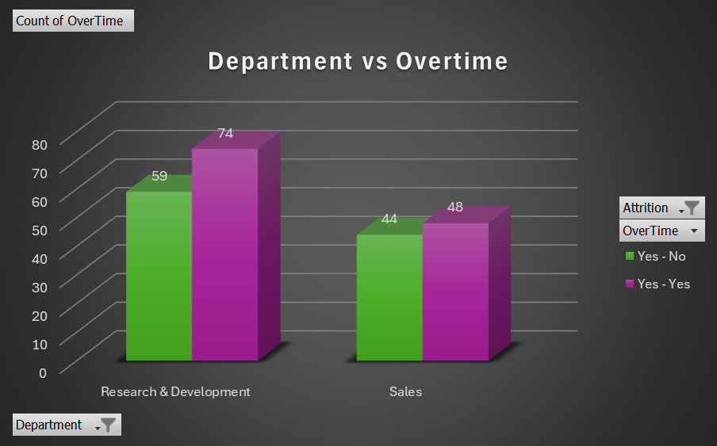
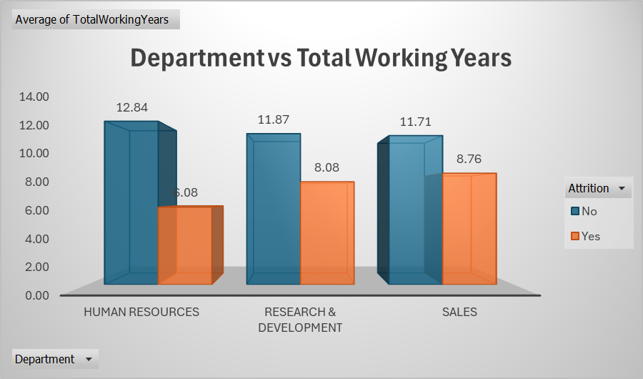
Attrition by Department, Job Mode, Total Working Years & Overtime
Attrition Breakdown:
56% of attrition comes from Research & Development.
Contract employees are the most affected.
Employees leave after an average of 8.08 years of service.
2. Overtime Contribution:
Overtime significantly impacts attrition in Research & Development and Sales.

Slide 12

Solution 4:
Retain
Retain Contract Employees: Implement retention strategies specifically for contract workers.
Reduce
Reduce Overtime: Focus on work-life balance improvements to decrease burnout from excessive overtime.
Career
Career Development Opportunities: Provide growth opportunities for long-tenured employees, especially in R&D and Sales.

Slide 13


Work Accidents, Salary, & Department Head Issues
Reasons for Leaving
23% due to work accidents, 22% due to salary dissatisfaction, and 19% due to issues with department heads.
Gender Differences
Males were more affected by these factors.
Solutions
Improve workplace safety, conduct salary reviews, and provide leadership training for department heads.

Slide 14
Key Takeaways:
High Attrition in Specific Roles:
Significant attrition in Research & Development and Sales departments.
Contributing Factors to Attrition:
Salary, stock options, work mode, and job satisfaction are key drivers of employee turnover.
Targeted Solutions:
Addressing these factors through salary adjustments, career development, flexibility in work policies, and engagement programs can significantly reduce employee attrition.

